Slide 1






Team
Nes Afriat V3 Leader & Presentor & Frontend programmer
Idan Rozenberg Frontend & Communication programmer
Tsuri Farhana Software Backend & Data programmer
Dan Roizman Software Backend & Data programmer
Yuval Hitter Software Backend & Data programmer

Slide 2
Load & Stress Testing

Slide 3


Why is it important?
Request
Request
Request
Request
Request
Request
Request
Request
Request
Request
Request
Request
Running slow
Going Down
User experience poor usability
Software vulnerabilities
Here we get into the crux of performance testing. It determines whether your software meets speed, scalability and stability requirements under expected workloads.

Slide 4
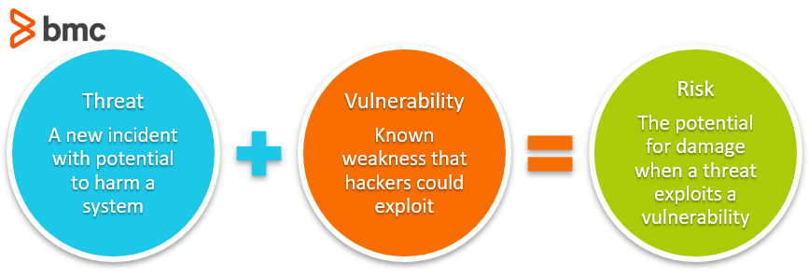
Vulnerabilities

Slide 5
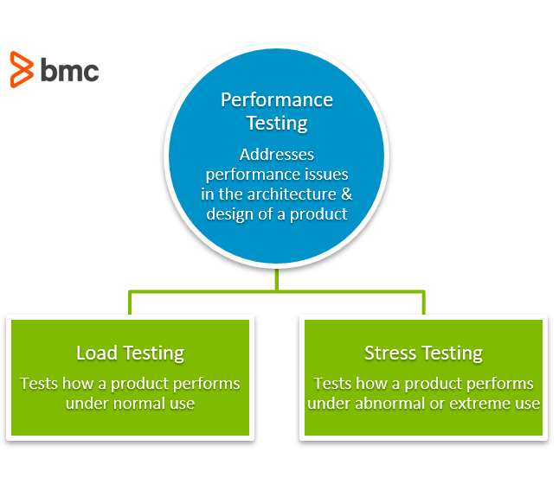
What are Load & Stress testing?

Slide 6

Load testing
Summary
Load testing is the process of putting pressure on a software, system, or device to measure its response under an expected load. By simulating production (pressure), load testing shows the behaviour under normal and expected peak conditions.
The goal is to ensure a given function, system, or program can handle what it’s designed for. This is important because when you’re building your product, you’re only accounting for a few individual users. Load testing helps you prepare for what happens when you deploy your product to hundreds or thousands of users.
Goals
We intentionally increase the load, searching for a threshold for good performance. This tests how a system functions when it faces normal traffic.

Slide 7
How to do load testing?
Create a dedicated Test Environment for load testing
Create Load Test Scenarios
Determine load testing transactions for an application
Prepare Data for each transaction
Number of Users accessing the system need to be predicted
Determine connection speeds. Some users may be connected via leased lines while others may use dial-up
Determine different browsers and operating systems used by the users
A configuration of all the servers like web, application and DB Servers
Test Scenario execution and monitoring. Collecting various metrics
Analyse the results. Make recommendations
Fine-tune the System
Re-test

Slide 8


Stress testing (a.k.a endurace testing)
Stress testing can include various activities such as:
Overloading the system with lots of jobs
Removing system components
Checking the behavior when the number of users suddenly increases (known as spike tests)
Checking the sustainability of a system over a period of time through a gradual increase in the number of users (known as soak tests)
Summary
Where load testing tests expected loads, stress testing applies unrealistic load scenarios—to the point of overloading the system till it breaks. The aim is to find out how stable your product is by stretching it beyond its bandwidth capability. Stress testing evaluates how an application will behave beyond normal conditions and normal peak load.
The goal of stress testing is to analyse the behaviour of the system after a failure. For stress testing to be successful, a system should display an appropriate error message while it is under extreme conditions
Goals
The main purpose of stress testing is to make sure that the system recovers after failure which is called as recoverability.

Slide 9
How to do stress testing?
Stress Testing process can be done in 5 major steps:
Planning the Stress Test. Here you gather the system data, analyze the system, define the stress test goals
Create Automation Scripts: In this phase, you create the Stress testing automation scripts, generate the test data for the stress scenarios.
Script Execuion: In this stage, you run the Stress testing automation scripts and store the stress results.
Results Analysis: In this stage, you analyze the Stress Test results and identify bottlenecks.
Tweaking and Optimization: In this stage, you fine-tune the system, change configurations, optimize the code with goal meet the desired benchmark.
Lastly, you again run the entire cycle to determine that the tweaks have produced the desired results. For example, it’s not unusual to have to 3 to 4 cycles of the Stress Testing process to achieve the performance goals

Slide 10
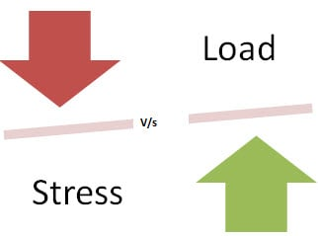
Load testing vs Stress testing - summary
Load Testing | Stress Testing
Load Testing is to test the system behaviour under normal workload conditions, and it is just testing or simulating with the actual workload | Stress testing is to test the system behaviour under extreme conditions and is carried out till the system failure.
Load testing does not break the system
The goal of those tests is not to find bugs (although you will find them as well) but to eliminate performance bottlenecks and check whether the system can sustain continuous expected load.

Slide 11
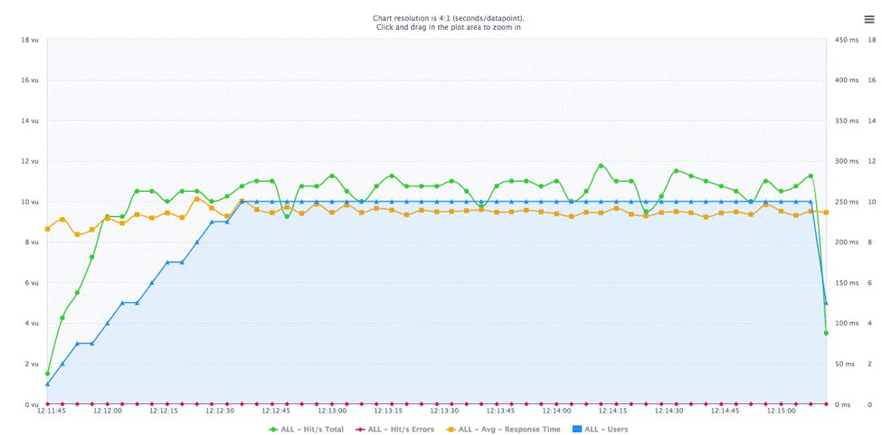
Output of load tests
Average Response Time
The average time that it takes for a request to move from the client to the server and the response to move from the server to the client.
Peak Response Time
The longest response time that occurs within a given performance testing cycle, which represents the ‘worst case scenario’.
.
Error Rate
The percentage of errors that occur during a given performance testing cycle.
Concurrent Users
The number of users that are active at any given point in time during a performance test, which simulates real potential load situations..
Throughput
The number of kilobytes per second that’s transmitted during a performance test cycle, which illustrates the amount of data going back and forth.

Slide 12
Output of stress tests
Measuring Scalability & Performance
Pages per Second: Measures how many pages have been requested / Second
Throughput: Basic Metric – Response data size/Second
Rounds: Number of times test scenarios have been planned Versus Number of times a client has executed
Application Response
Hit time: Average time to retrieve an image or a page
Time to the first byte: Time is taken to return the first byte of data or information
Page Time: Time is taken to retrieve all the information in a page
Failures
Failed Connections: Number of failed connections refused by the client (Weak Signal)
Failed Rounds: Number of rounds it gets failed
Failed Hits: Number of failed attempts done by the system (Broken links or unseen images)

Slide 13
How is it beneficial to our program?
STRENGTHS
Throughput
Response time
Speed
Stability
Resource usage
Recovery
WEAKNESSES
Page load issues
System lag
Additional issues arising when multiple users accessing the system
S
W
OPPORTUNITIES
provides stakeholders
with crucial information about their application that affect their product.
THREATS
Memory leaks
Race conditions
Synchronization issues
O
T

Slide 14
Why not acceptance & unit testing?
Testing purpose - Functional tests are testing the accuracy of the software with definite inputs against expected output while the performance tests verify the behavior of the system at various load conditions.
Uses of Load & Stress testing (which are not covered by functionality testing) -
Verify the numbers of concurrent users which an application can support, and scalability to allow more users to access it.
Check out that current infrastructure is sufficient to run the application or not.
Assure that application able to achieve the performance point recognized during performance testing.
Determine the operating capacity of an application
Discovering new bugs (hardware) - which are not possible with the other testing methods. Such as memory management memory leaks, bugs, buffer overflows, etc
Discovering new failures and vulnerabilities:
Make sure that the system has saved the data before crashing or not.
Check whether any unexpected failures do not harm the system security

Slide 15
So what is the solution?

Slide 16
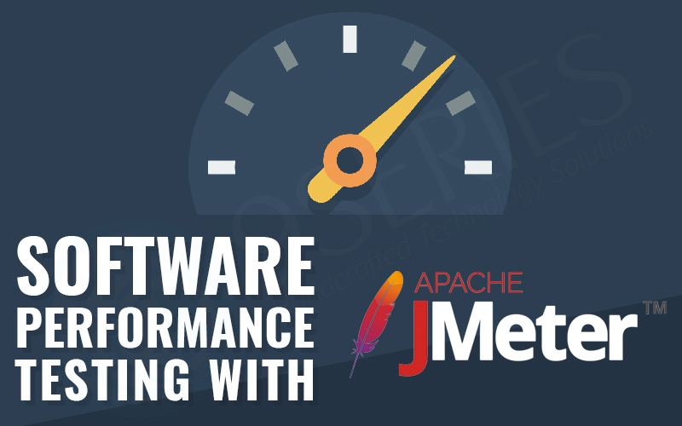
Apache JMeter™
The application is open-source software, a 100% pure Java application designed to load test functional behavior and measure performance.
It can be used to simulate a heavy load on a server, group of servers, network or object to test its strength or to analyze overall performance under different load types.

Slide 17
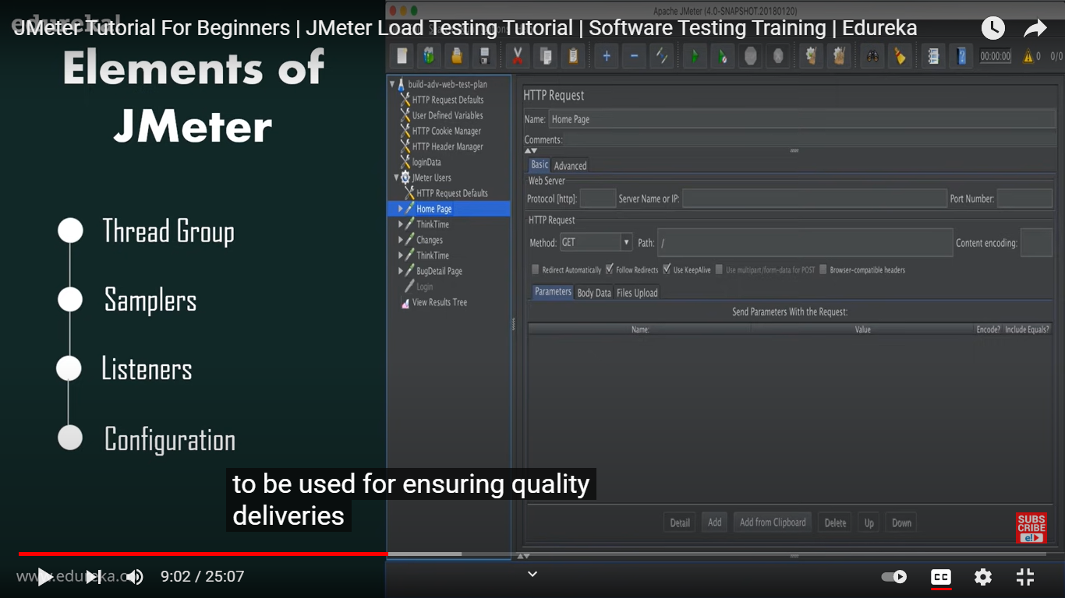
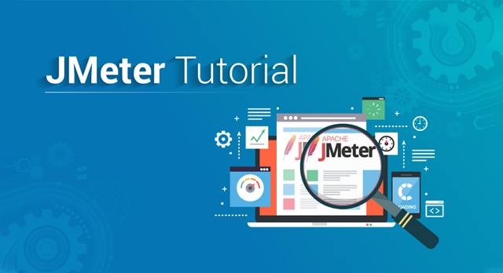
JMeter Elements

Slide 18
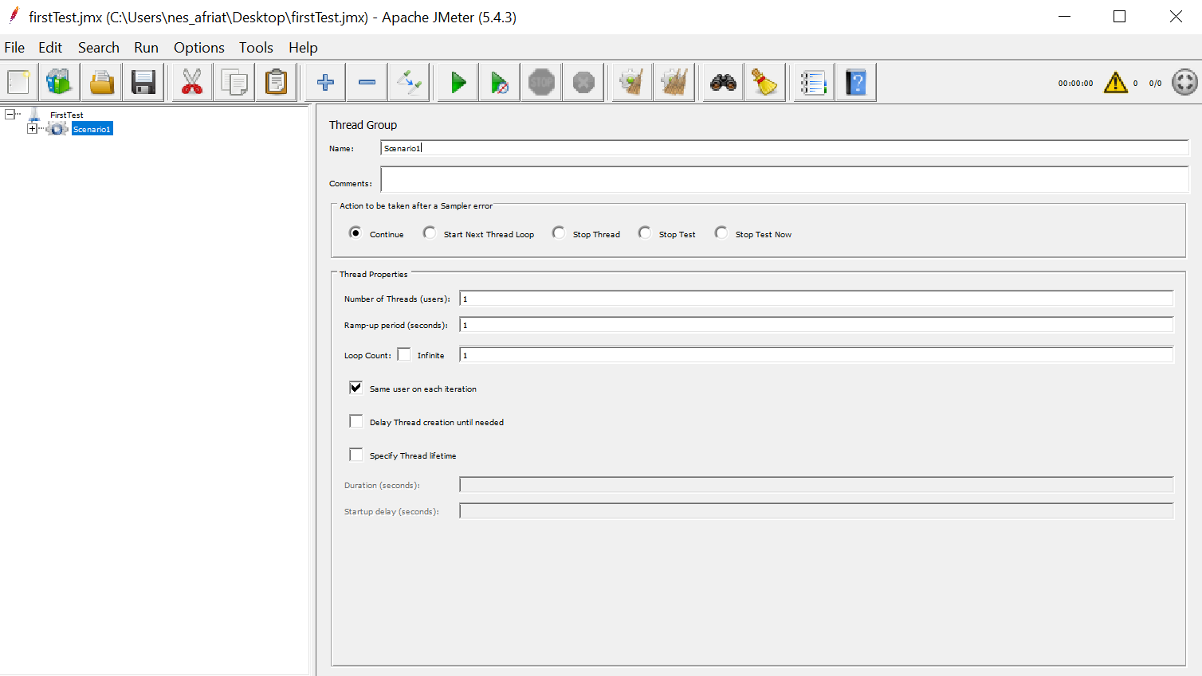
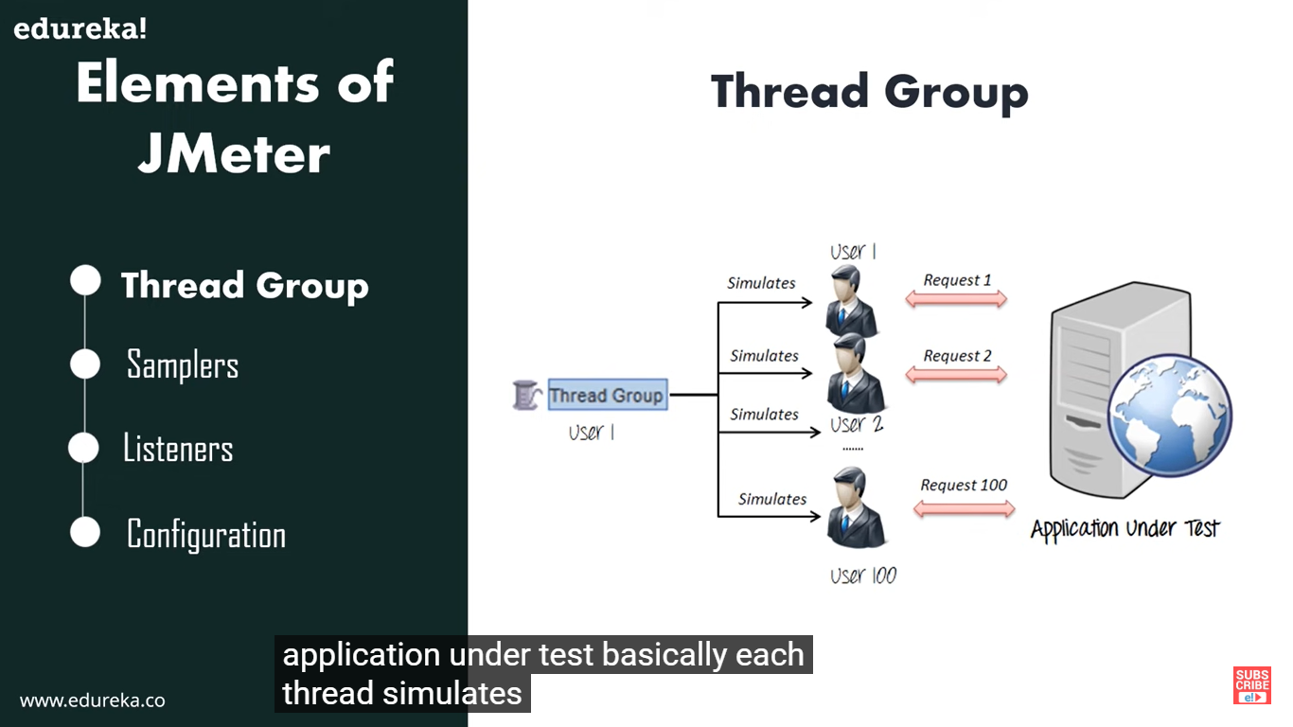
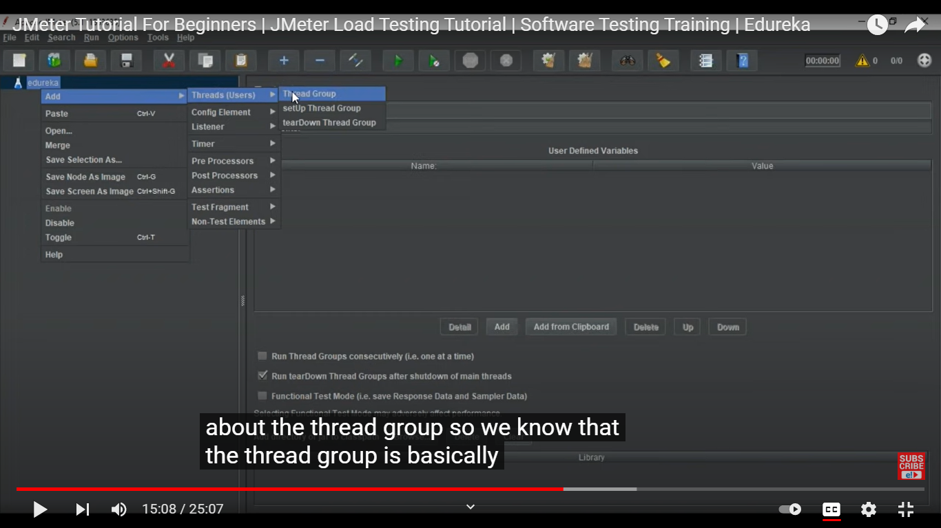
Thread group
Access through:
מה לעשות בעת כישלון
מספר טרדים
מרווח זמן בין כל הפעלה של טרד
מספר חזרות

Slide 19
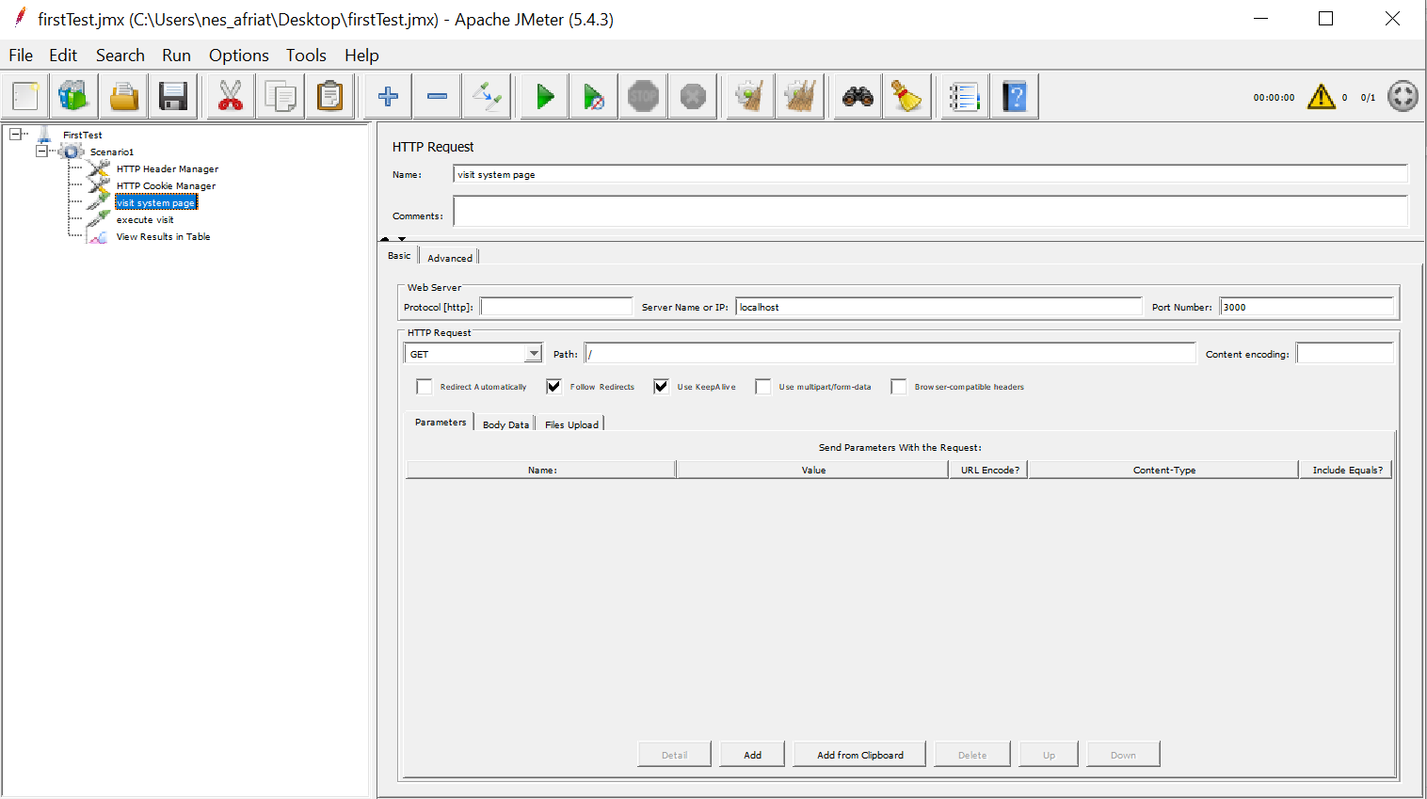
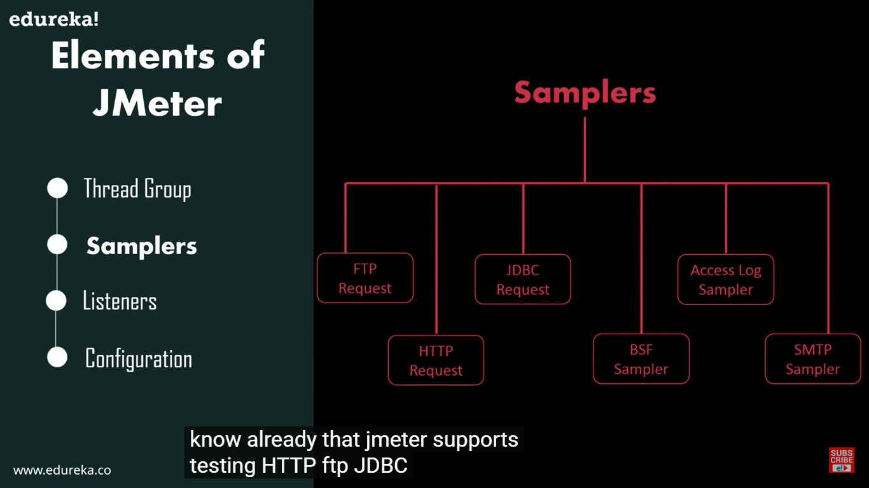
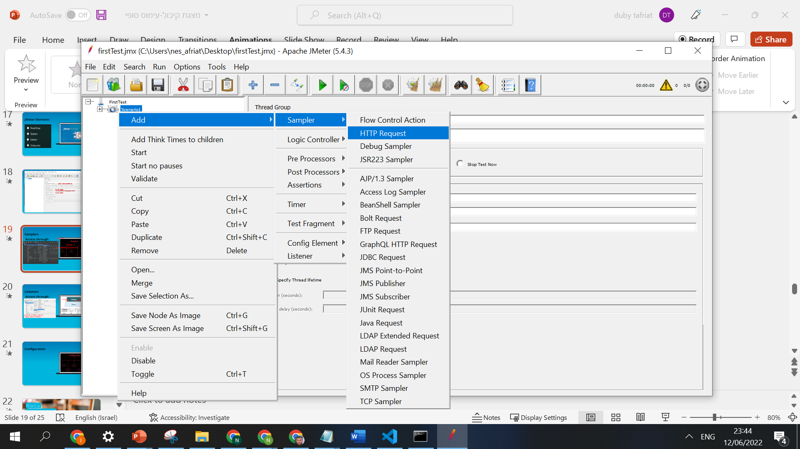
Samplers
Access through:
שם לבדיקה
פורט לחיבור לוקלי
שם השרת
סוג בקשה
הנתיב לפנייה (הבקשה/פעולה רצויה)

Slide 20
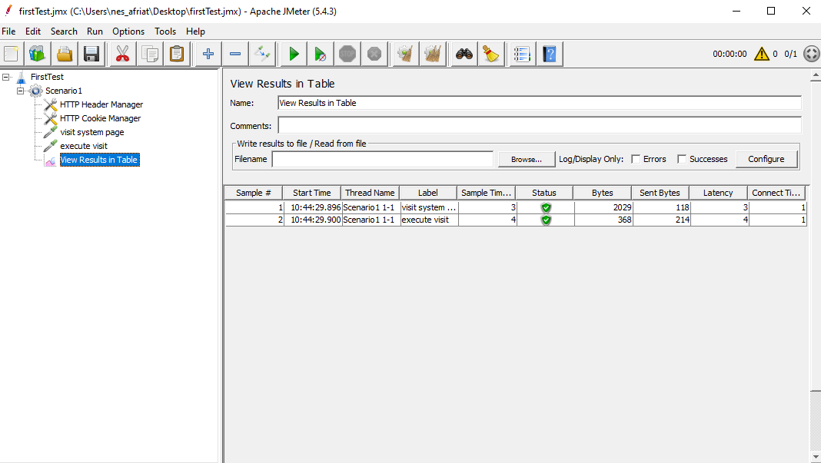
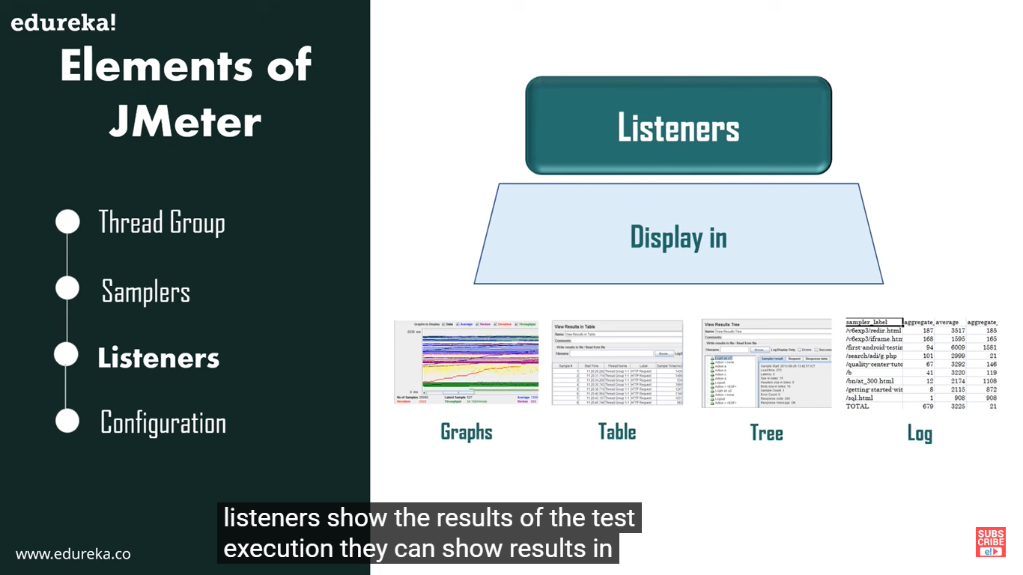
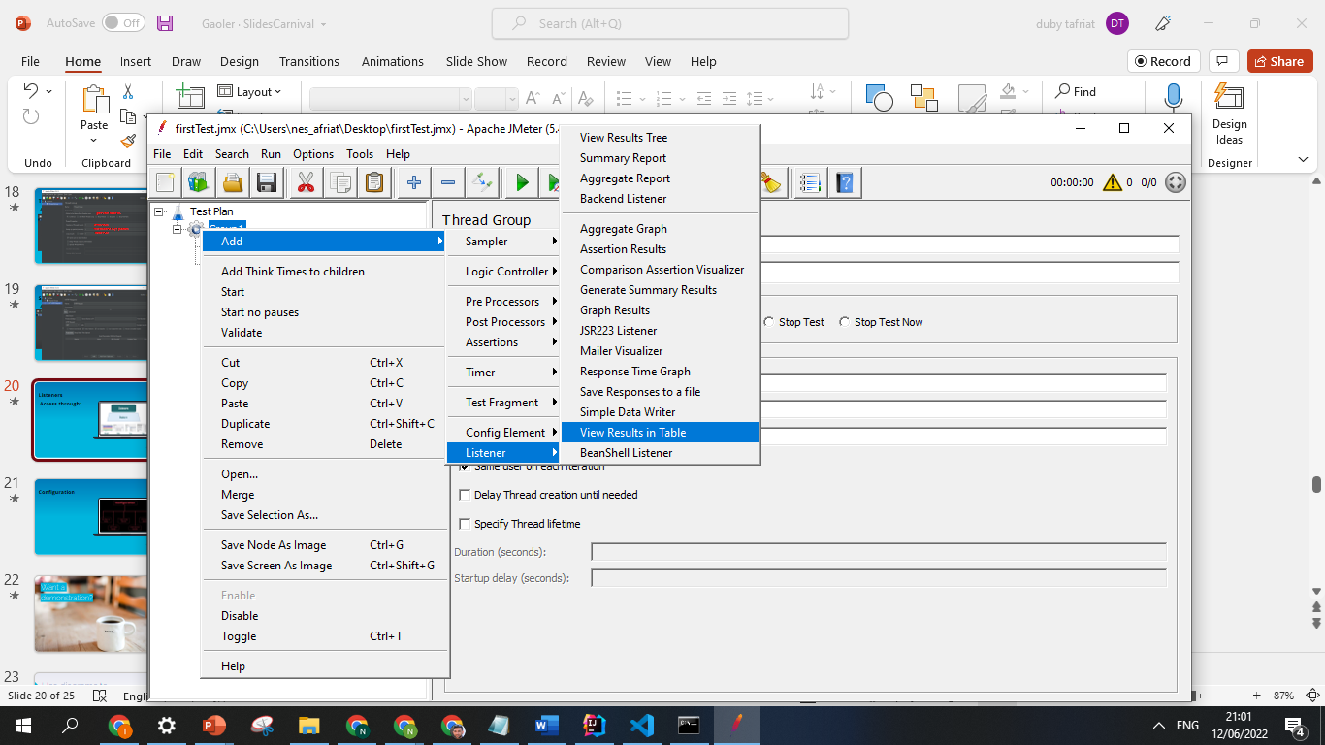
Listeners
שם הדו"ח
Access through:
זמן הדגימת נתונים
פלט אחרי ששומרים ומריצים את הטסט(נשמר גם כקובץ זמני בדוקס)
מספר טרד ומספר לולאה
הצליח\נכשל
גודל מידע שנשלח
משך זמן ביצוע פעולה
זמן התחברות

Slide 21
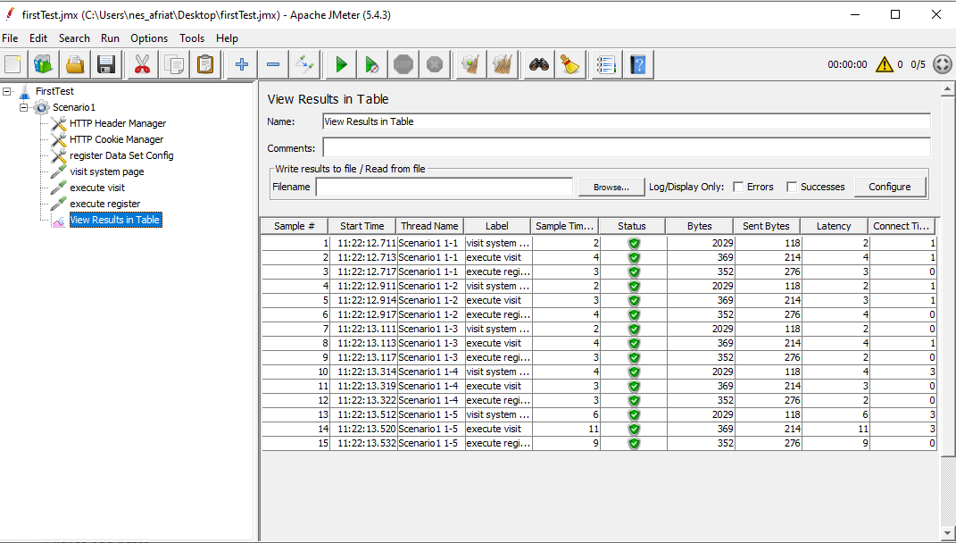
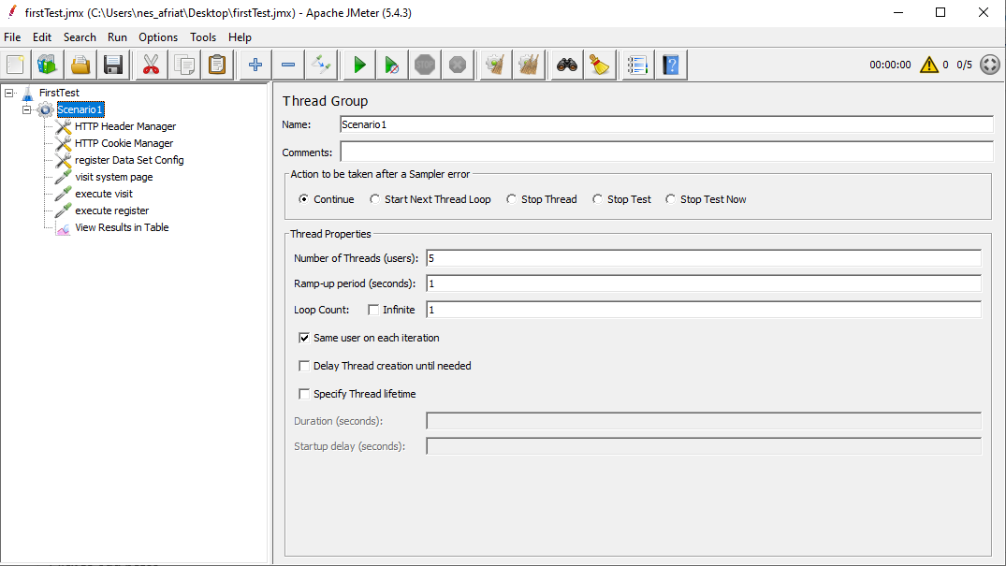
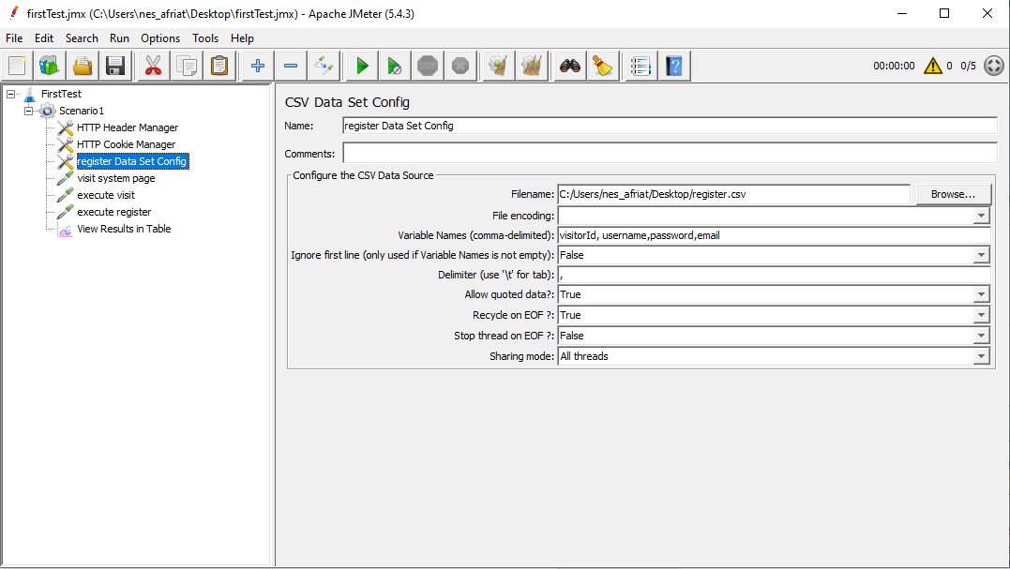
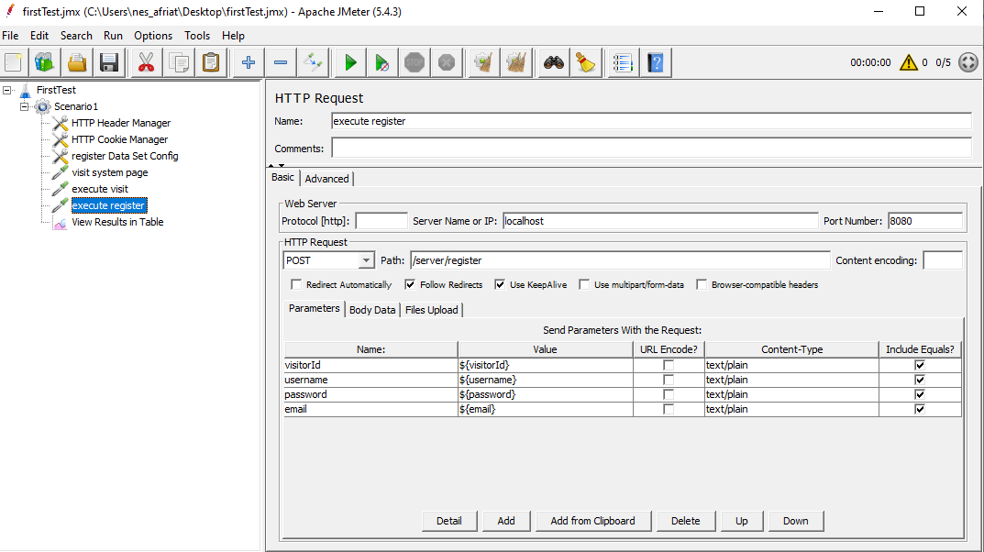
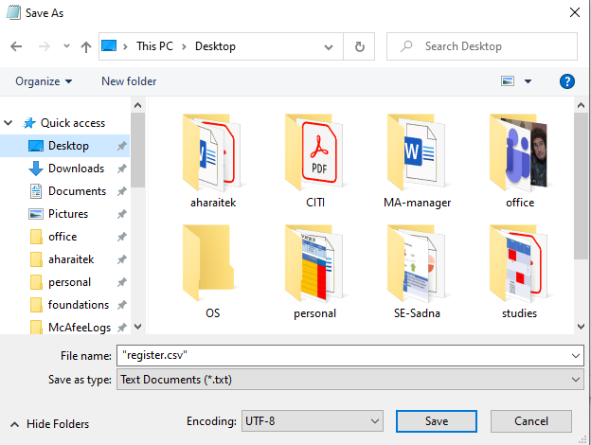
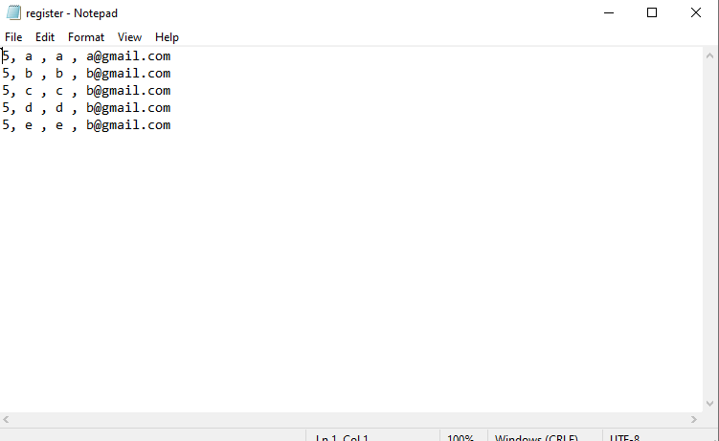
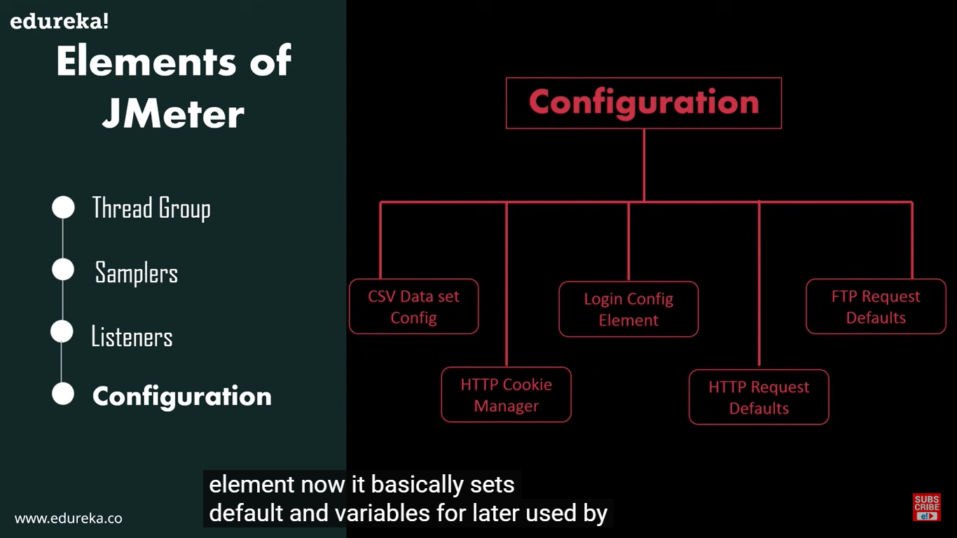
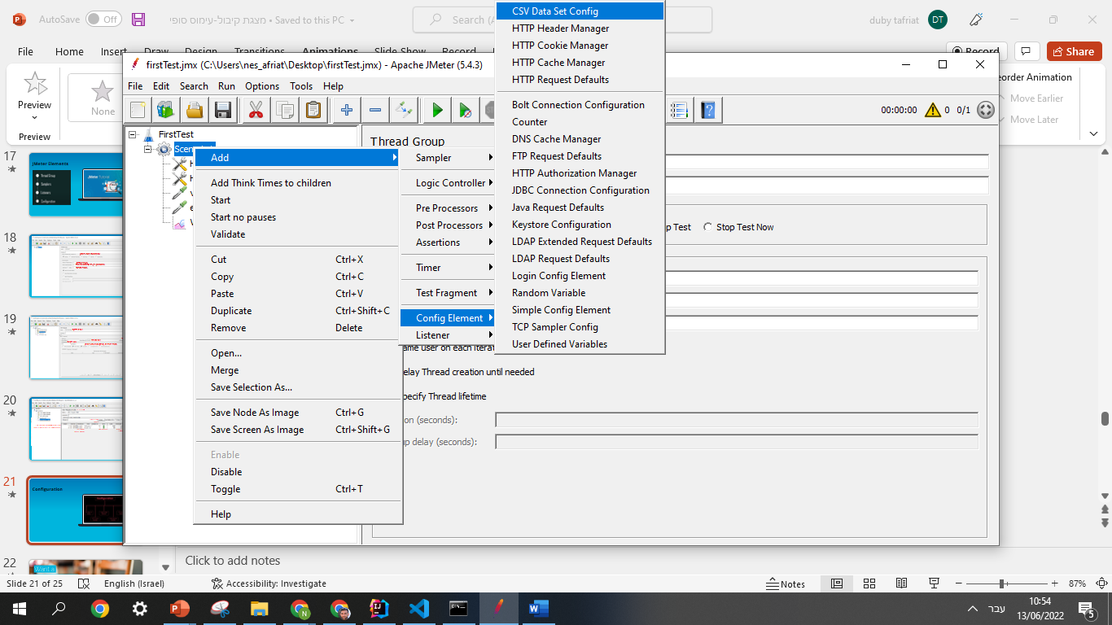
Configuration
Access through:
שם הקונפיג
נתוני קלט עבור הפעולה:
5 משתמשים שנתוניהם מסודרים ומופרדים בפסיקים
טעינת קובץ הנתונים
שם השרת
נתיב לחיבור לאחר הכניסה לשרת
הפרמטרים מופרדים בפסיק
סוג הפעולה
מספר התואם את כמות הפרמטרים
נתיב לפעולת רישום
סוג המפריד שבחרנו לנתונים
מחזור נתוני הקלט בעת סיום הקובץ
שמות הפרמטרים
נתוני הקלט בתוך סוגריים עם $
הצורה שבה שומרים את הקובץ

Slide 22

How do we use it?

Slide 23
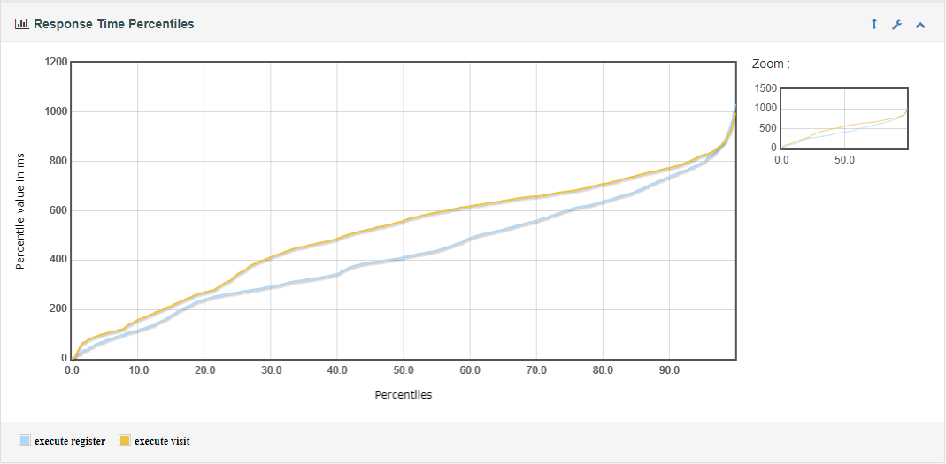
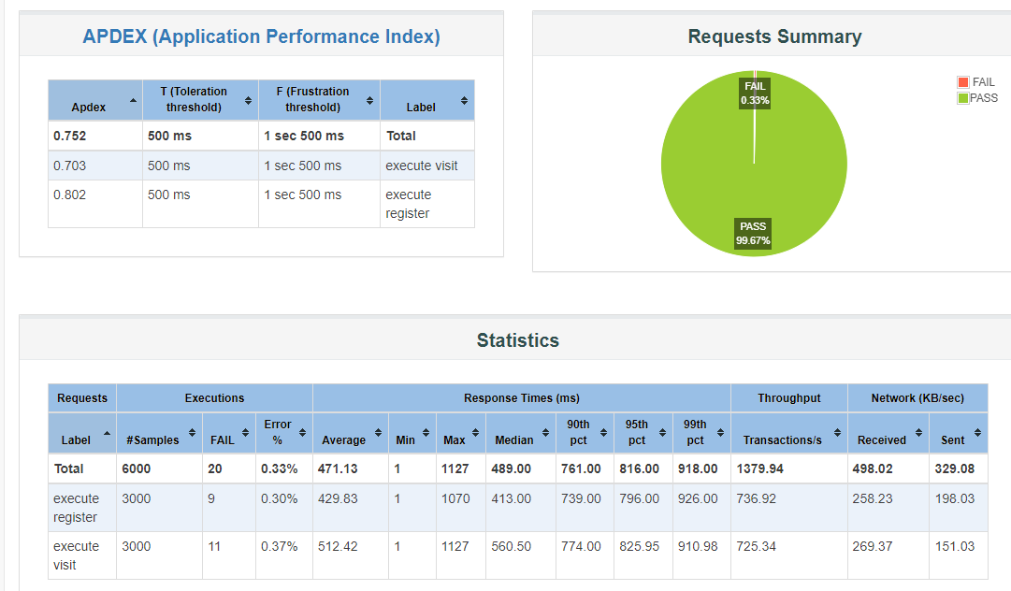
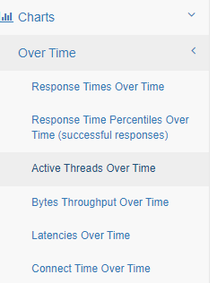
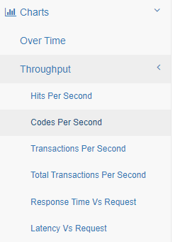
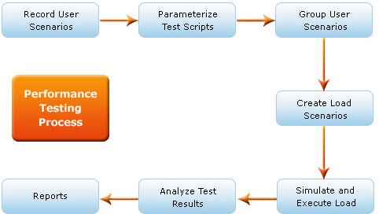
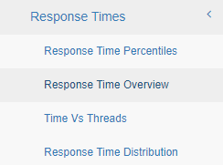
Identify the performance bottlenecks
Analyze client-side report to find bad behavior:
High response time
High latency
Low throughput
Errors
increasing Bytes downloaded for every request
Analyze server-side report
CPU, Memory, Disk I/O, Network I/O, and JMX.
Eliminate outer resources such as DB for pure code evaluation.
Compare between the reports to identify suspicious components
Find the bottlenecks using pattern matching and fix the issues.
Bottlenecking — This occurs when data flow is interrupted or halted because there is not enough capacity to handle the workload.
Notes:
observed very high disk write response times, often in excess of second. This is represents really poor performance!
A logical bottleneck on the database server, due to an inefficient stored procedure
An I/O bottleneck on the database server
When we looked at queue lengths on the disk, our diagnosis of a disk bottleneck were confirmed. Here we see average queue lengths of over 9,000 requests!!
he Application Server was a configured with 2 hyper-threads. So this was the 100% of one logical processor was the maximum CPU that could be consumed by this process.
This indicated that the application server was CPU bound.
A CPU bottleneck on the application server

Slide 24
Examples for testing scenarios
Scenario 1
Do variuos actions on the system
Increase the amoust of user commiting visit system
Search for bottleneck at the user entry point to the system
Scenario 2
Add some of the same products to various users carts
purchase these products stimultansly from thee users
Search for purchase bottlenecks and synchronization issues
Scenario 3
Register few members to the system
Login to the same members from many visitors stimultansly
Search for login bottlenecks and synchronization issues

Slide 25
THANKS!
Any questions?

